Slide 1
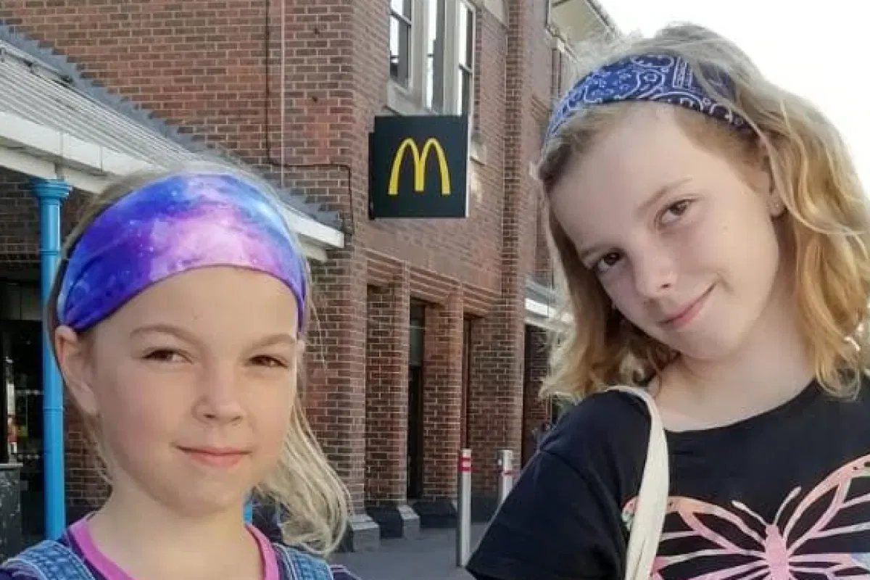
Caitlin and Ella McEwan

Slide 2
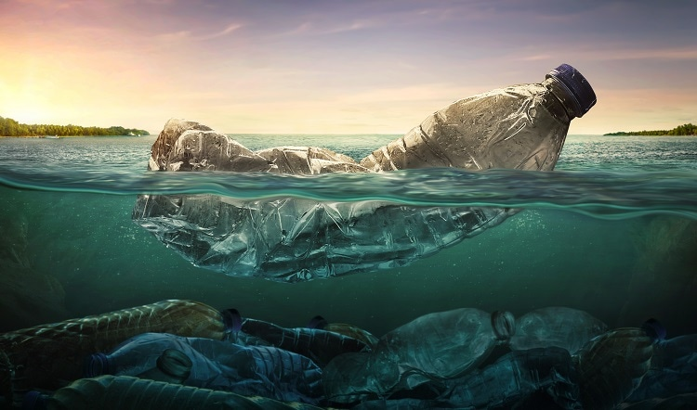
PLASTIC

Slide 3
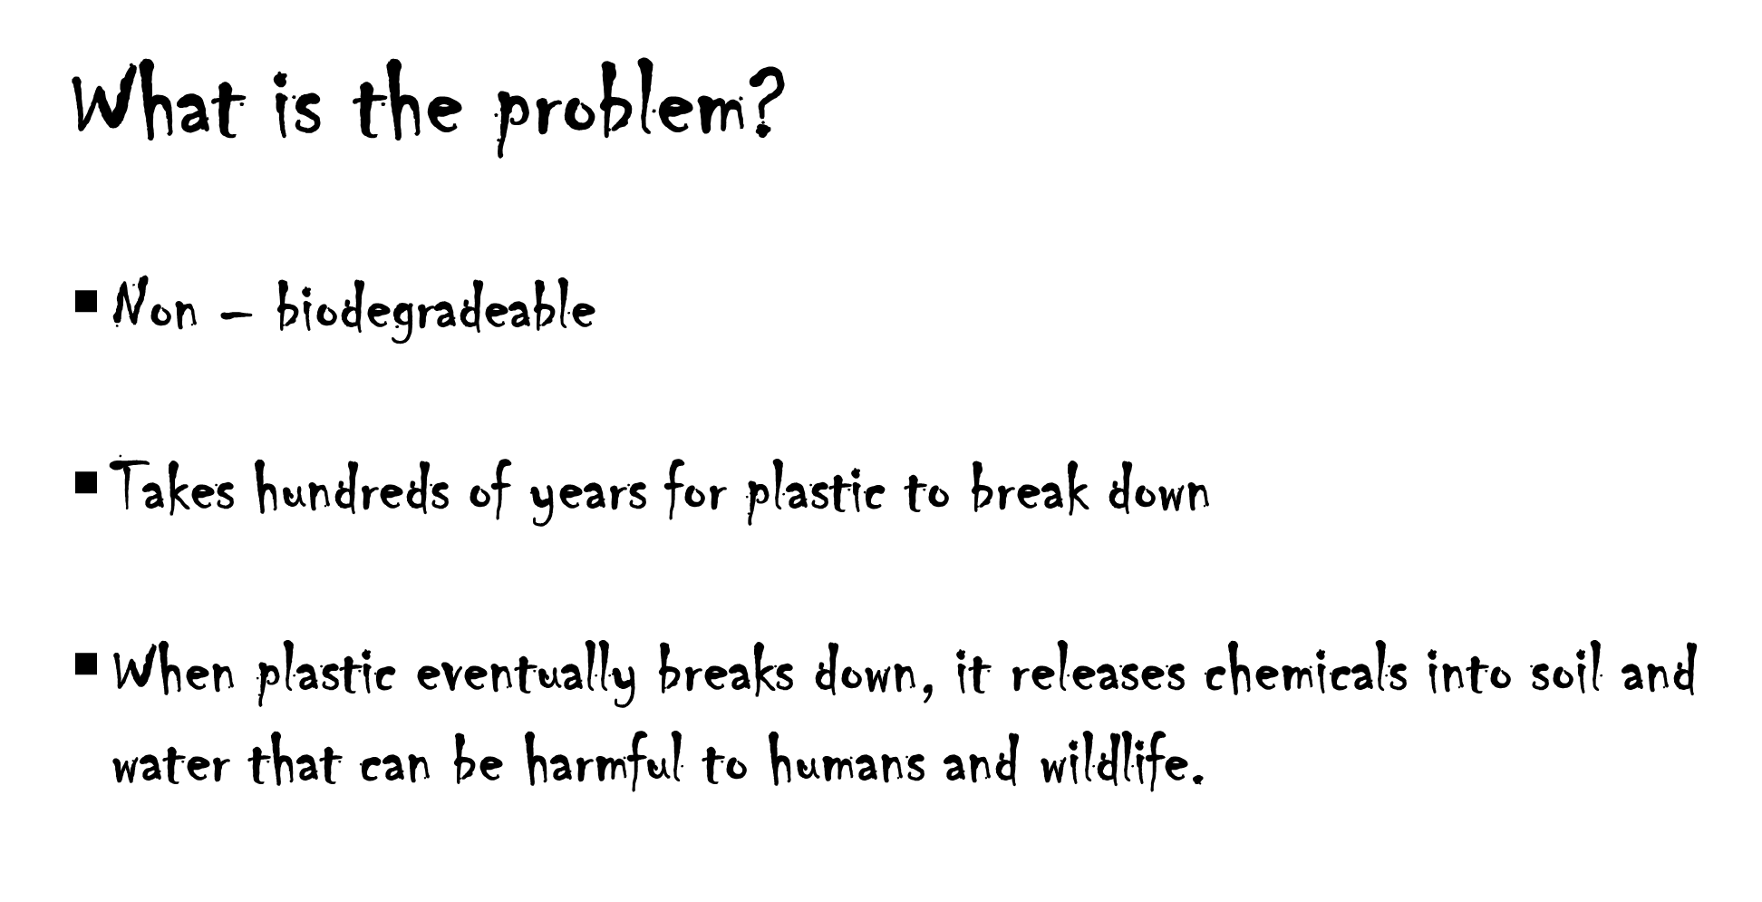
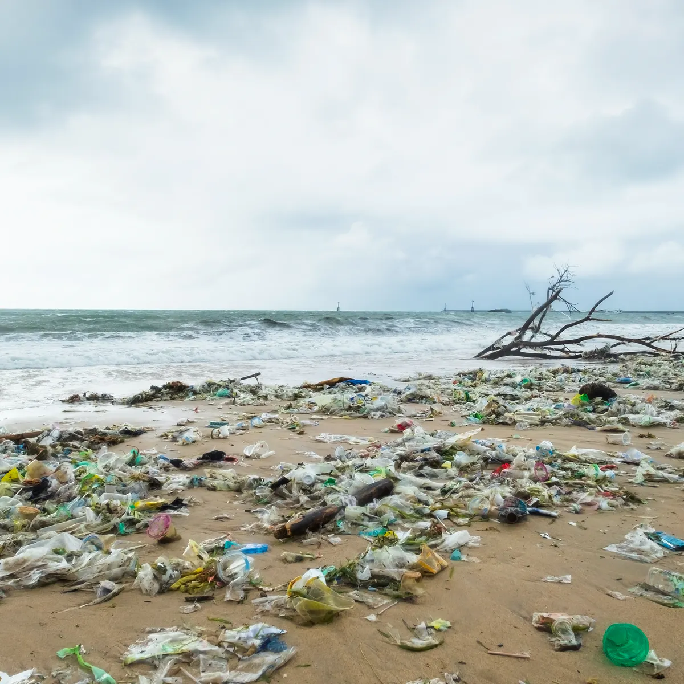

Slide 4
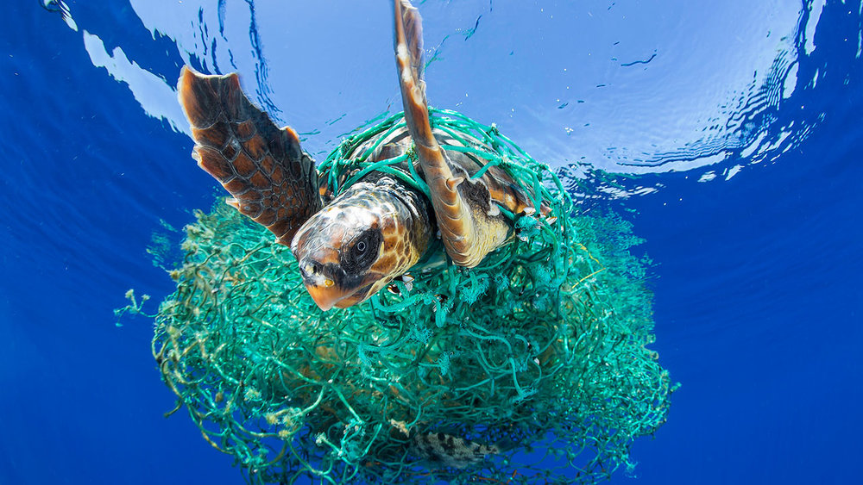

Slide 5
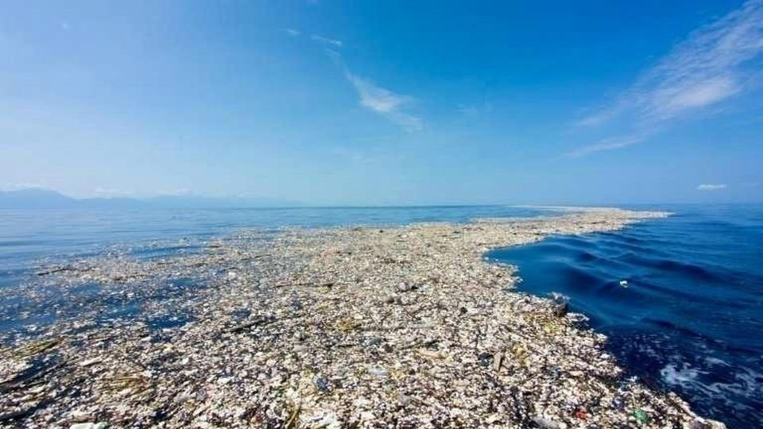
The Great Pacific Garbage Patch

Slide 6
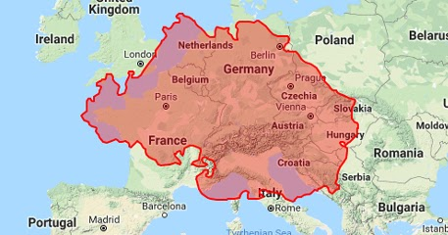

Slide 7
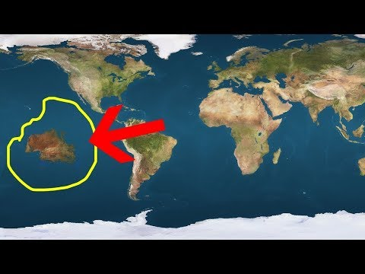

Slide 8
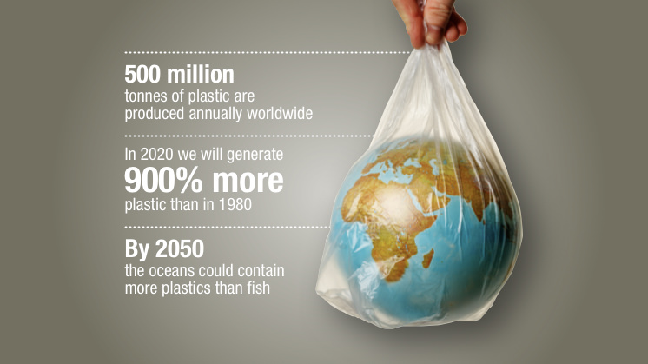

Slide 9
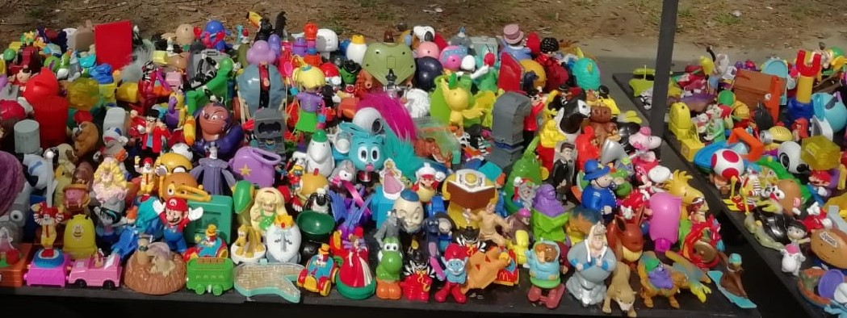

Slide 10
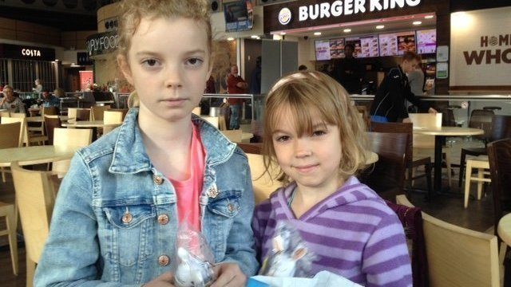
We like to go to eat at Burger King and McDonald’s, but children only play with the plastic toys they give us for a few minutes before they get thrown away and harm animals and pollute the sea.
We want anything they give to us to be sustainable so we can protect the planet for us and for future generations

Slide 11
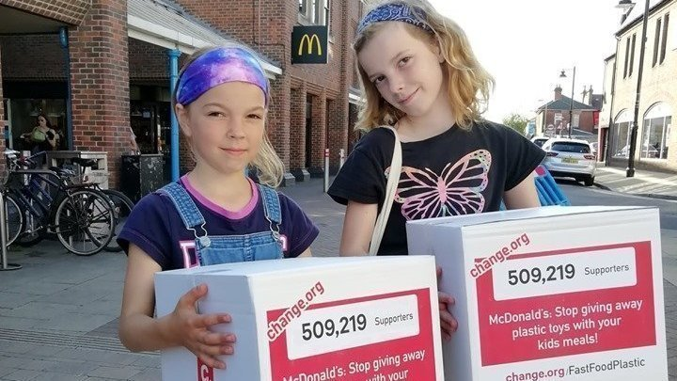

Slide 12
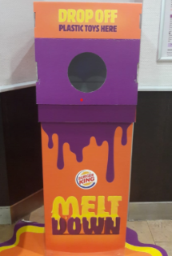
Burger King have stopped using plastic toys
In 2019 McDonalds reduced the number of plastic toys that they included in their meals;
By 2021, McDonald’s will not be using plastic toys.

Slide 13
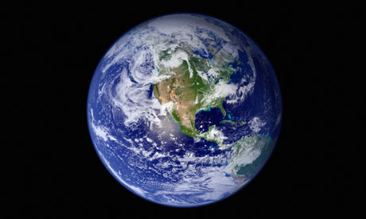
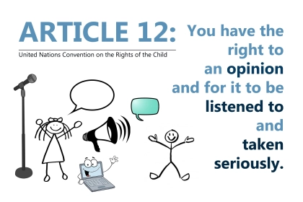

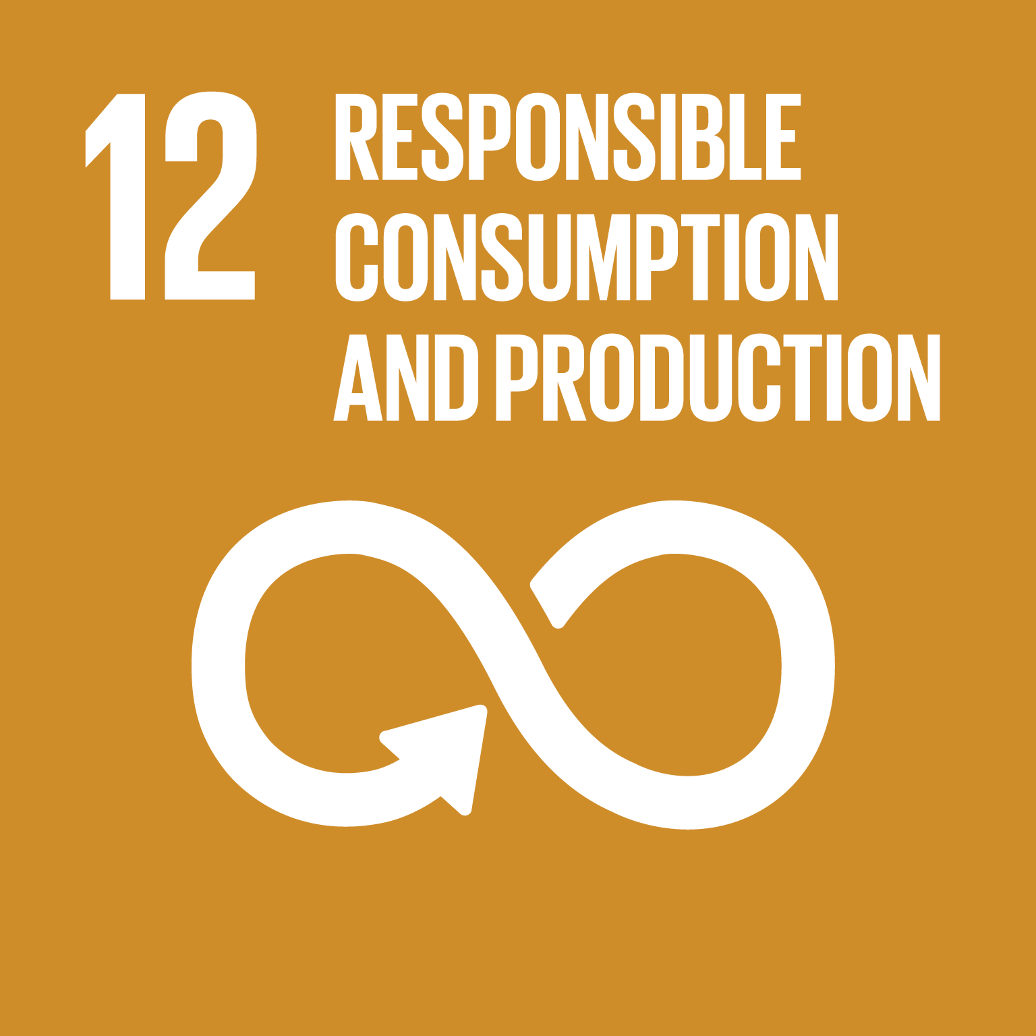
Are Ella and Caitlin McEwan learning to change the world?
Yes - by campaigning for well known companies to stop them using plastic toys which harm wildlife and oceans.

Slide 14

Do Ella and Caitlin McEwan follow our values?
YES
Justice – they are doing what is right and fair to help save wildlife and oceans.
Mercy – they show compassion to wildlife and the oceans they live in.
Humility – they put the needs of wildlife and the oceans before their own needs as children by not wanting plastic toys to play with.

Slide 15
‘It makes us very sad to see how plastic harms wildlife and pollutes the oceans and we want to change this.’ Ella and Caitlin McEwan
Which plastic item will you stop using?
Why?
What will you use instead?

