Slide 1
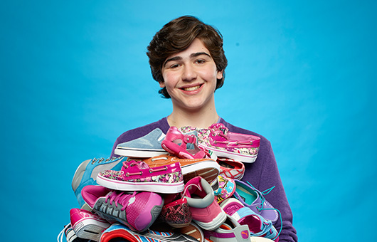
Nicholas LOWINGER

Slide 2
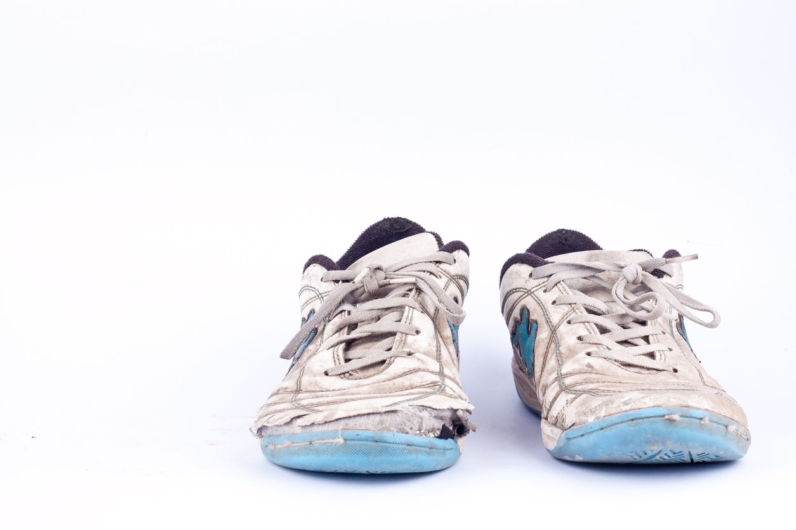
Nicholas Lowinger visited a homeless shelter when he was 5. He was wearing a pair of new trainers with lights in the sole which he wanted to show the other children but his mum said that would not be a good idea because for many of the children ……….
Shoes were broken
No shoes at all;
Shoes were shared
No school
Sore feet
So Nicholas started donating his own used shoes and clothes to the shelter

Slide 3


Slide 4
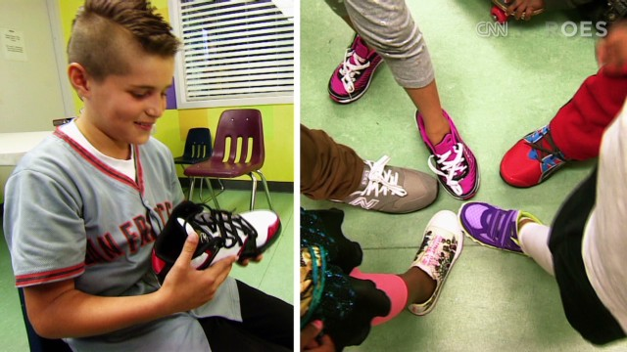

Slide 5
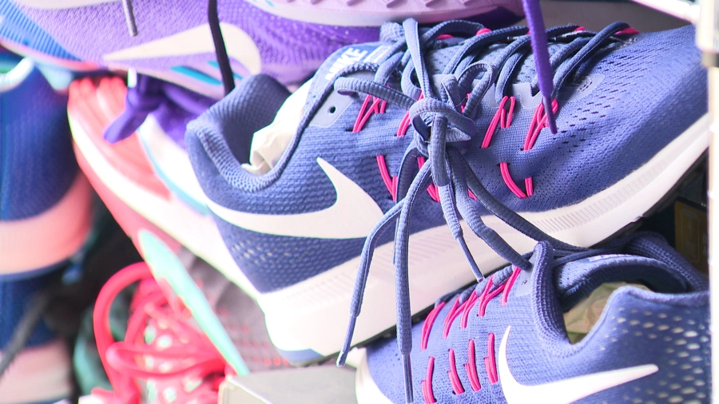
Gotta have sole have provided:
100,000 pairs of shoes/trainers for homeless children
Set up a Scholarship Award to help homeless children go to college
Organises annual events to raise more money
Provides shoes to soldiers and their families who live below the poverty line

Slide 6



Is Nicholas Lowinger learning to change the world?
Yes - by providing shoes, children can go to school and have a good education. In turn, they will be able to have good jobs and not be homeless.

Slide 7

Does Nicholas Lowinger follow our values?
YES
Justice – providing shoes so that homeless children can go to school
Mercy – being compassionate and kind to children who have less than himself
Humility – not showing off his shoes as a child and by donating his own shoes and clothes.

