Slide 1
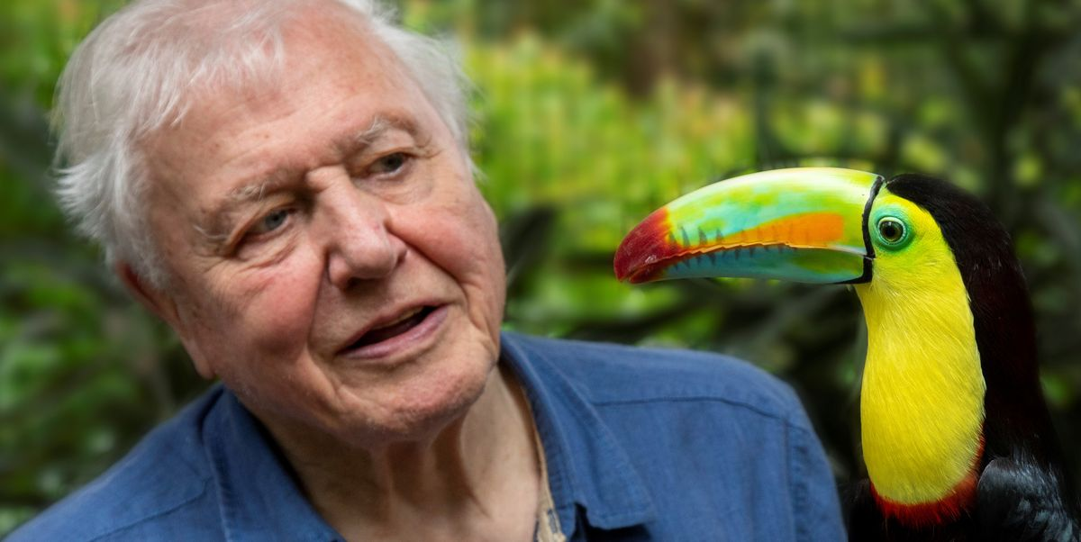
Sir David Attenborough

Slide 2
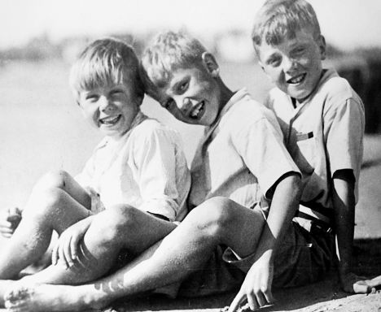
Sir David Attenborough was born in 1926 and was the youngest of 3 brothers;
As a child he collected fossils, stones and natural specimens. He used these to set up his own museum;
He went to university and studied geology (the study of the Earth) and zoology (the study of animals);
He started to work for the BBC in 1952 and made his first documentary in 1969.
Sir David was:
Sir David was:
Sir David was:

Slide 3
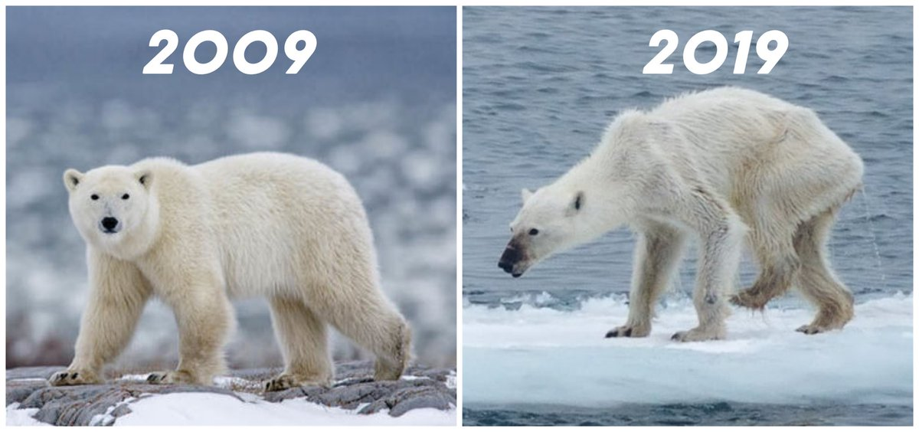
During his travels, David Attenborough has seen the changes that are happening to the world because of the things that humans are doing.

Slide 4
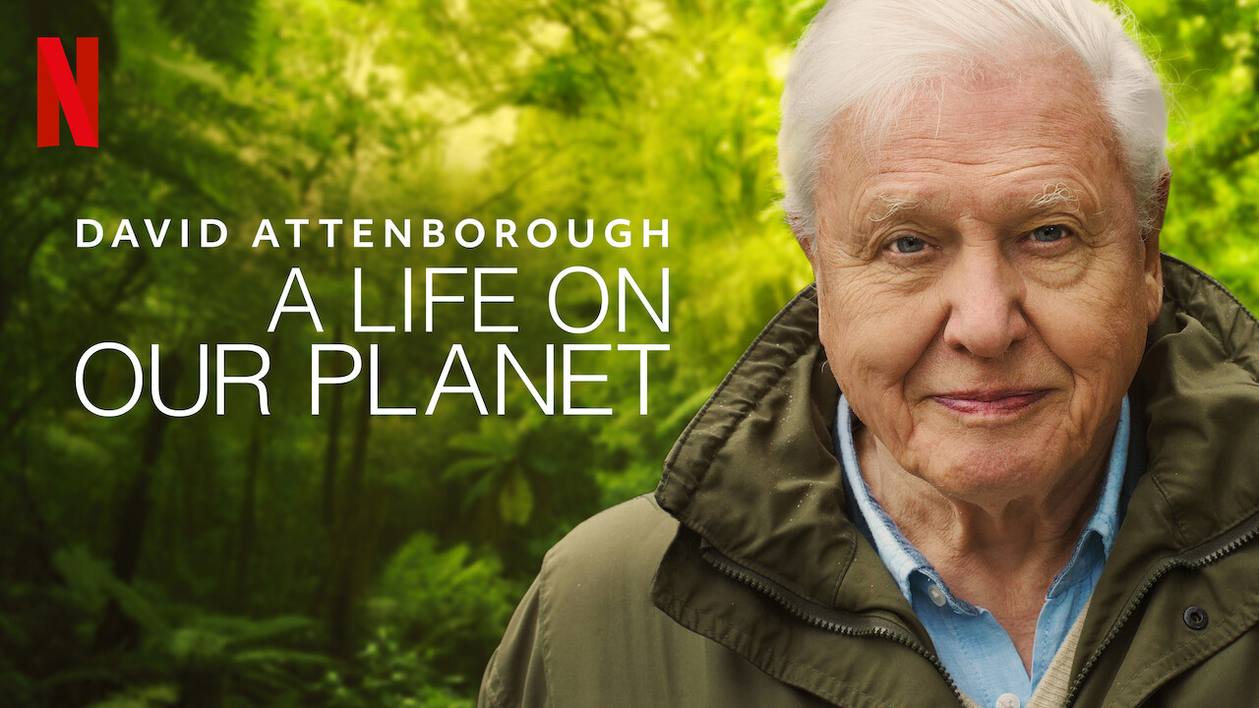

Slide 5
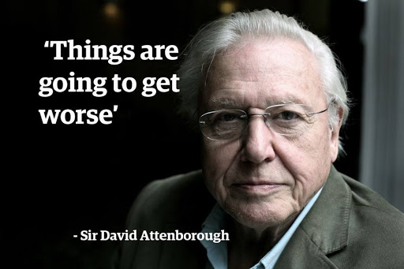
What are you going to do to make sure they don’t?

Slide 6
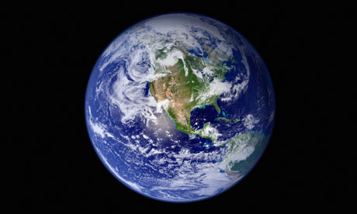



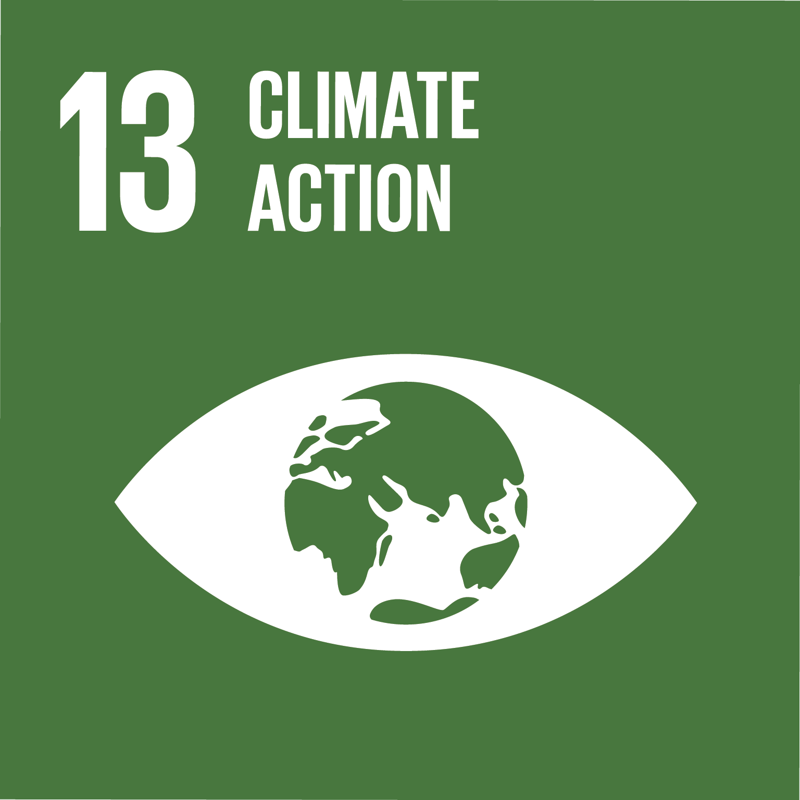
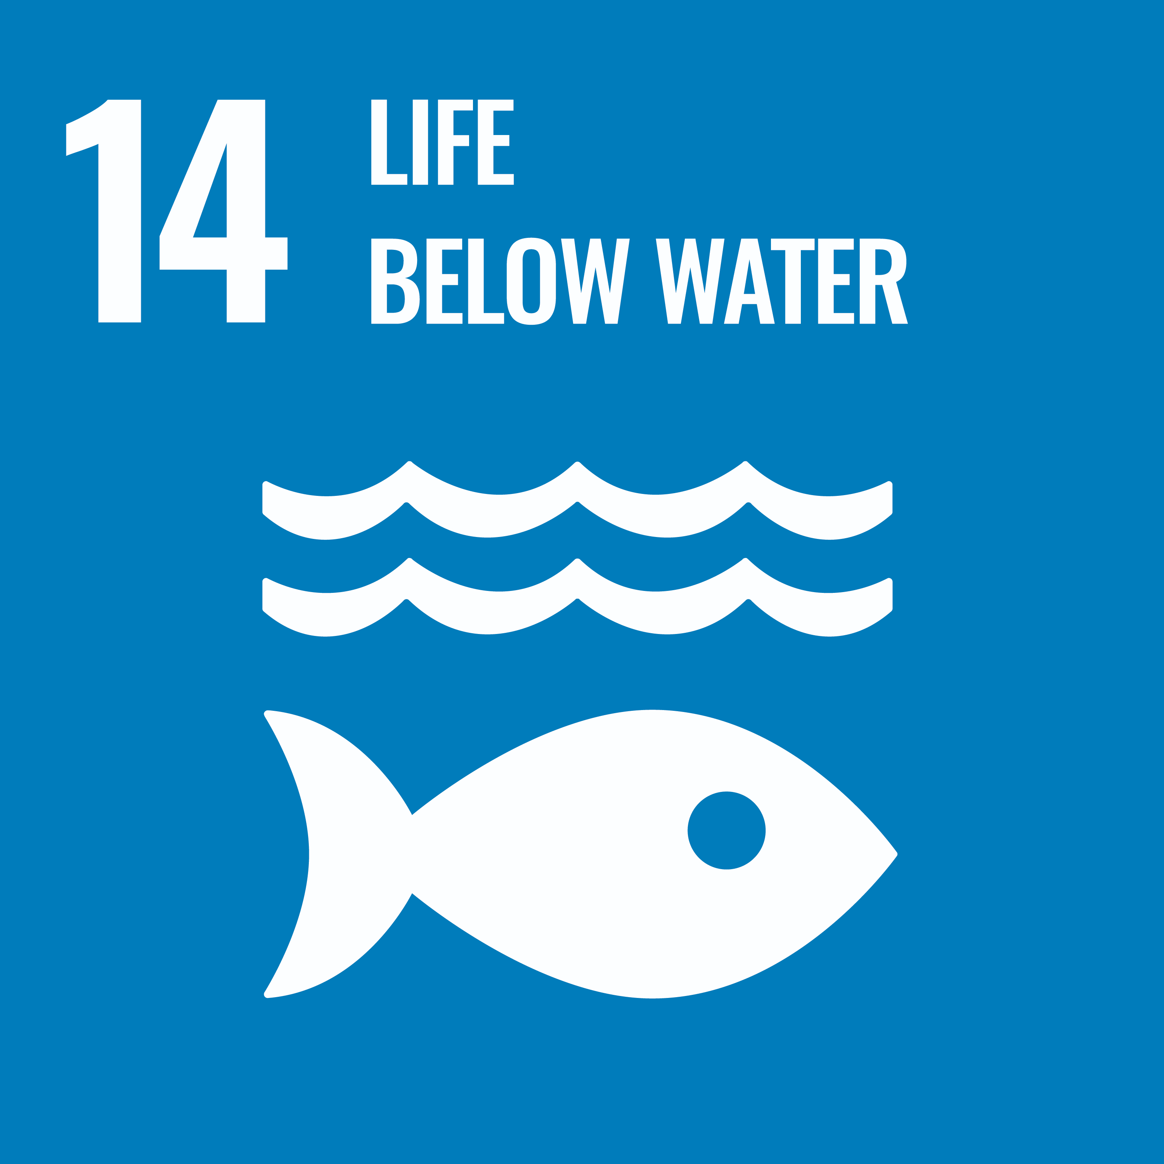
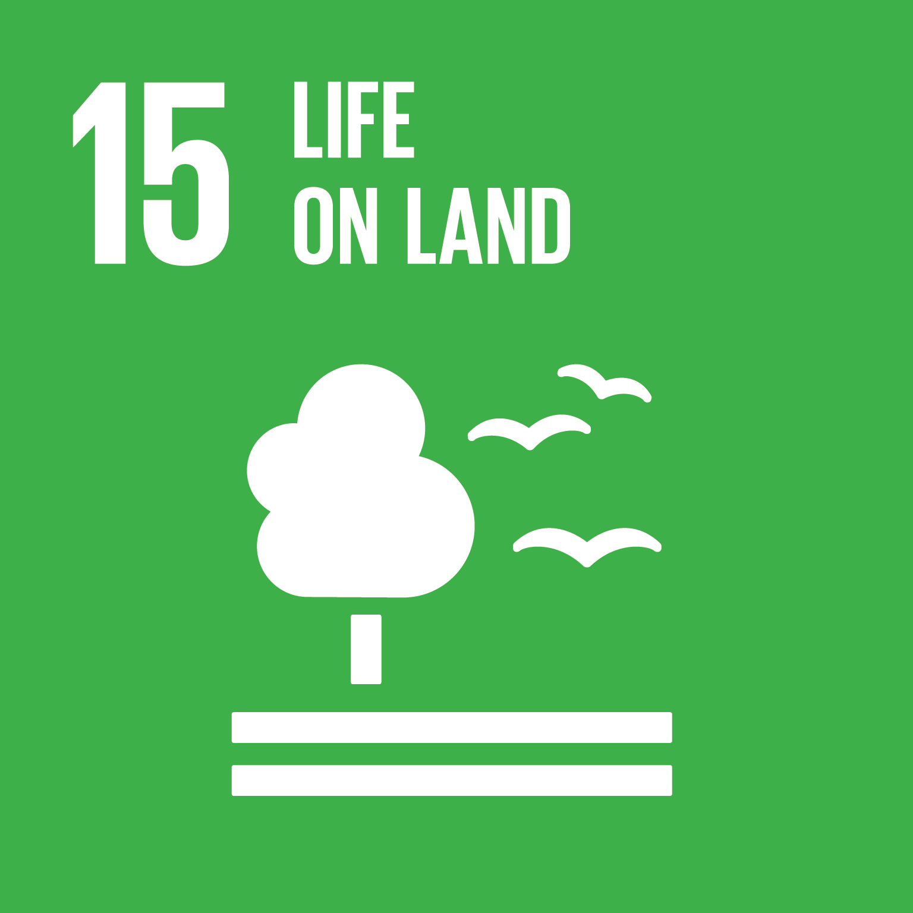
Is Sir David Attenborough learning to change the world?
Yes - by making us aware of the damage that humans are doing to our planet, what will happen if we do not change and telling us the changes we need to make.

Slide 7
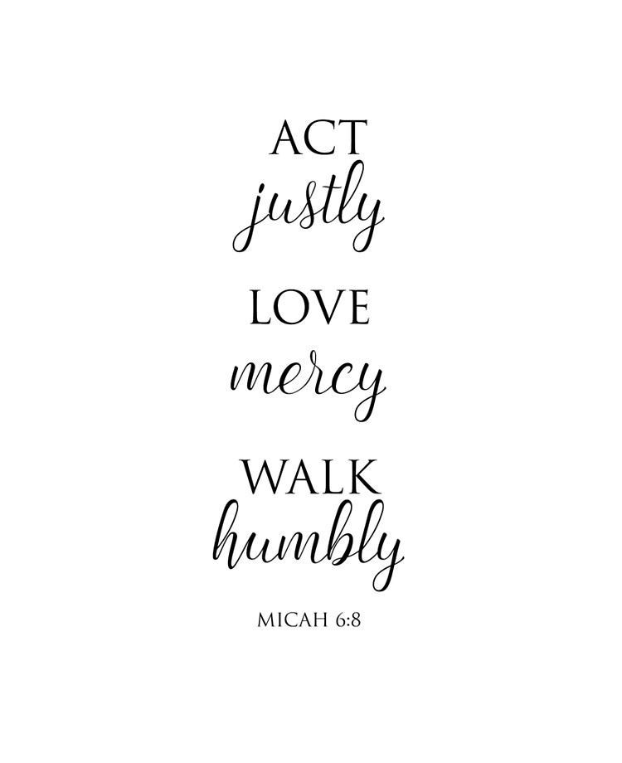
Does Sir David Attenborough follow our values?
YES
Justice – he is doing what is right and fair to help save the planet.
Mercy – he shows compassion to animals and other living things and their environments.
Humility – he puts the needs of animals and other living things before his own showing how important they are to our survival.

