Slide 1

Chalking the Door
The festival of Epiphany

Slide 2
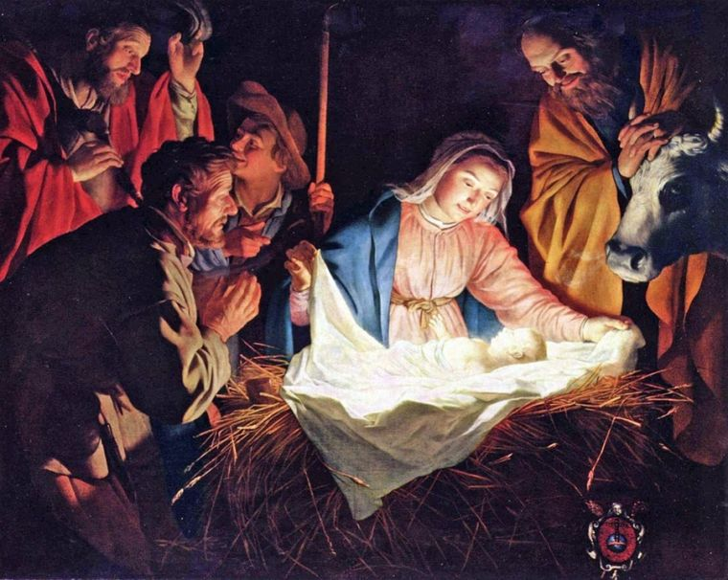

Slide 3
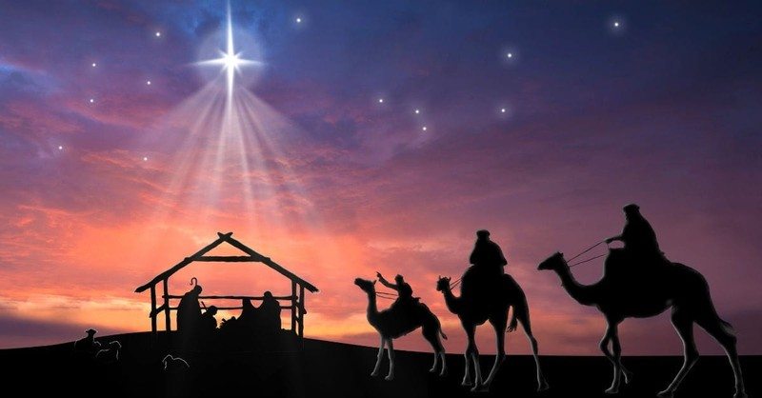

Slide 4
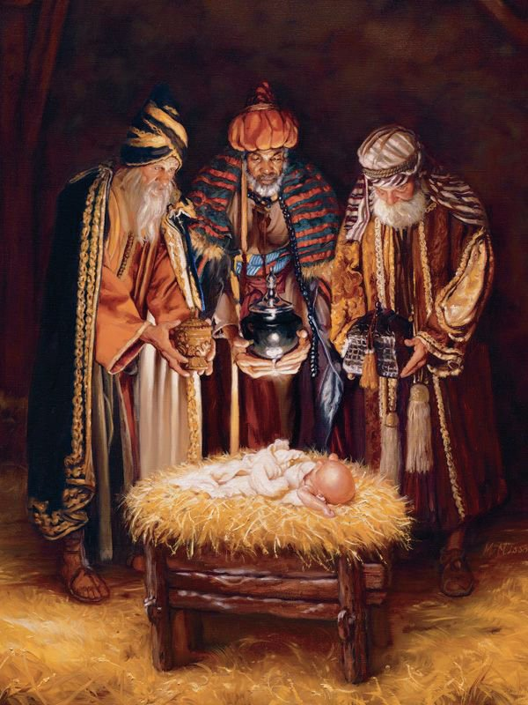

Slide 5
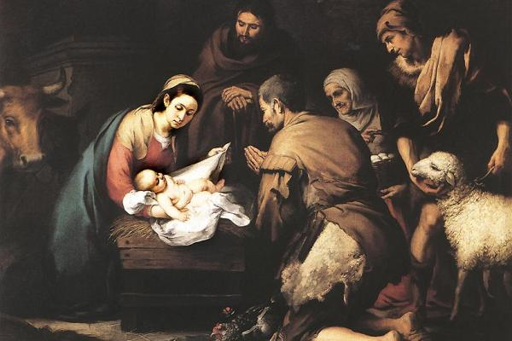

Slide 6


Slide 7
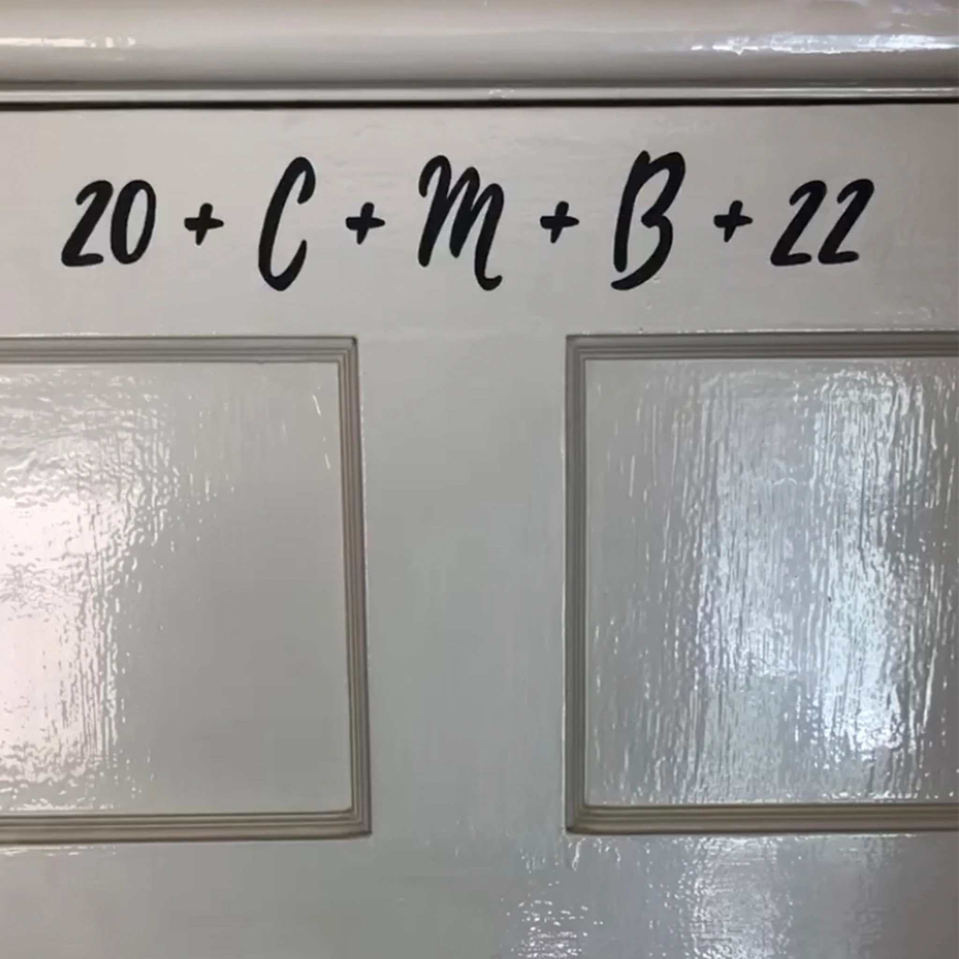

Slide 8
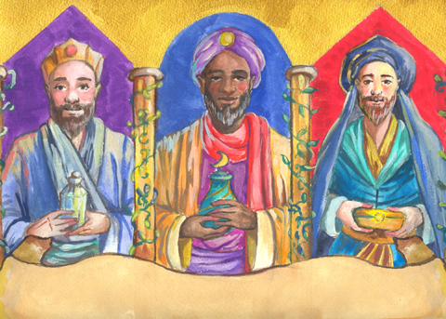
Casper Melchior Balthasar

Slide 9

Christus Mansionem Benedicat
May Christ bless this house

Slide 10
Epiphany House Blessing
Please come and join our family in our home.
Please watch over us and all who come in and go from this house, and please provide for us.

