Slide 1
Maths at ST STEPHEN’S
Fractions, decimals and percentages

Slide 2
Our aim...
To help you to understand our approach to learning fractions, decimals and percentages.
To help you to understand the reasons behind our approach.
To help you to support your child with their maths at home learning fractions, decimals and percentages.

Slide 3
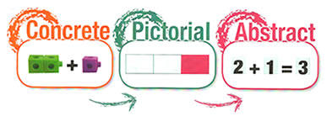
Our maths approach is…..
A mastery approach.
A CPA approach.

Slide 4
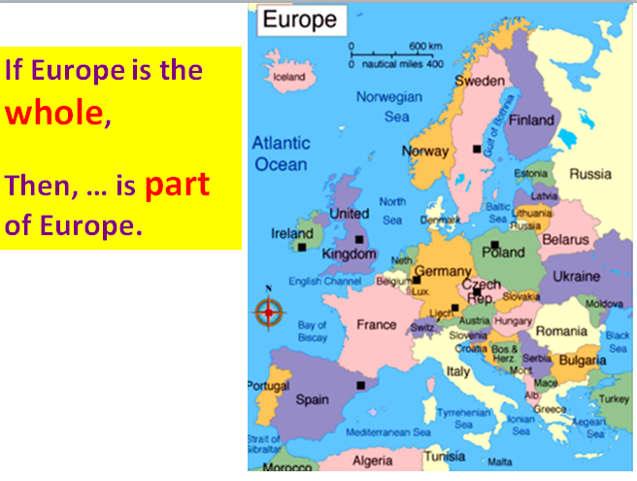
Then link to being equal.

Slide 6
As this point, parts aren’t equal.

Slide 7
Introduction of equal and not equal (unequal)

Slide 8

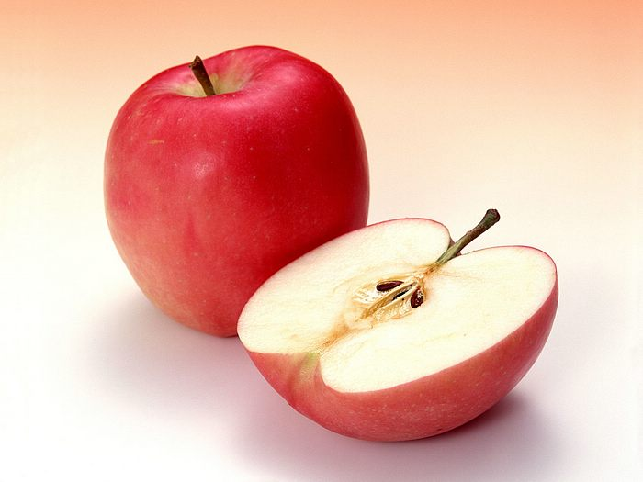
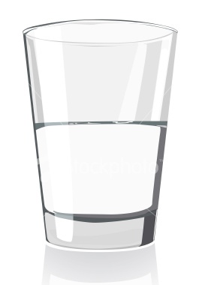

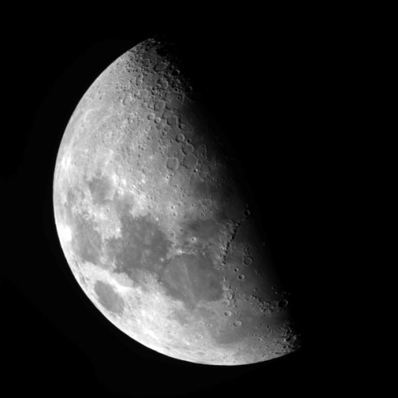
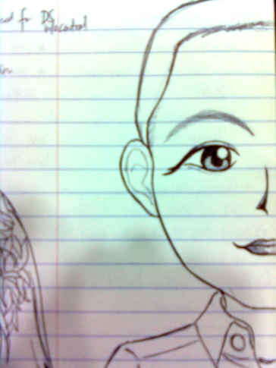


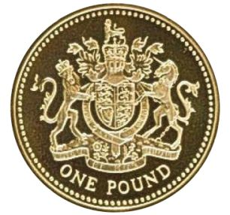
What is a fraction?
Can you think of images that we use in our teaching to represent ½?

Slide 10
CONCRETE
Your task:
1. Take a bottle and fill it with 1/5 water.
What do you need to know to be able to do this?
2. Fill another bottle to a different unit fraction?
What do you need to know to be able to do this?
3. Repeat.
4. Order these unit fractions from smallest to biggest.
What do you notice about unit fractions?

Slide 11
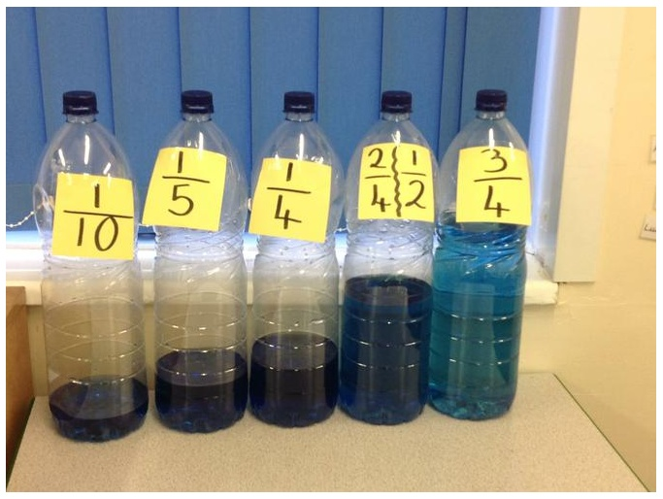
These can also be used for decimals and percentages and
exploring the relationships between these three concepts.

Slide 12
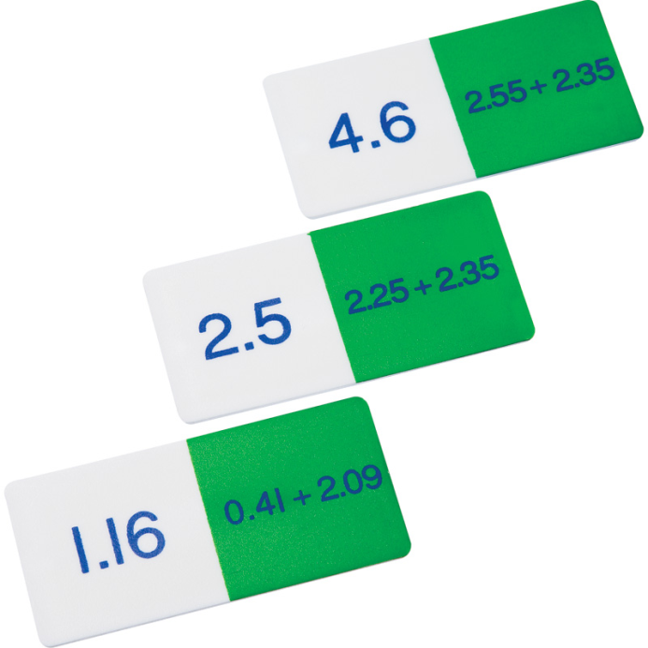
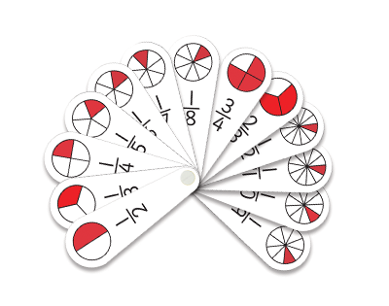
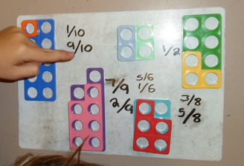
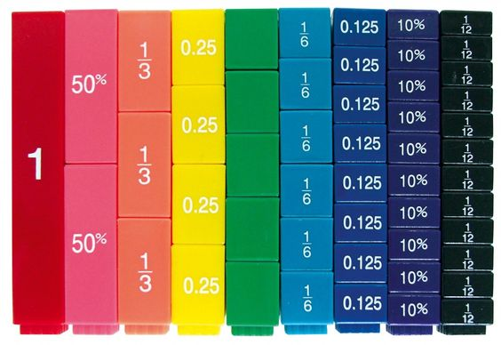

Slide 13
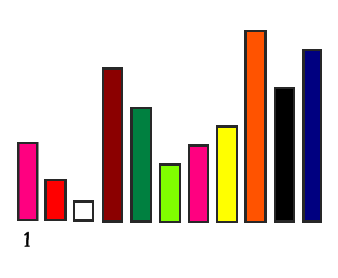
Deepening learning
Notes:
Videos – Caroline Ainsworth – NCETM Cuisenaire rods
Speaking frame – “are we all agreed that the…. red rod can be called a 1/2….white rod can be 1/4 or ½ of a ½.
Making sure order of the rods are chosen carefully – and the name of the first rod is carefully selected .
How would you change for 1/6 and 1/3

Slide 14
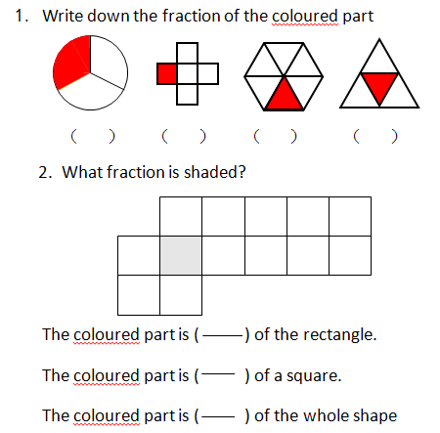
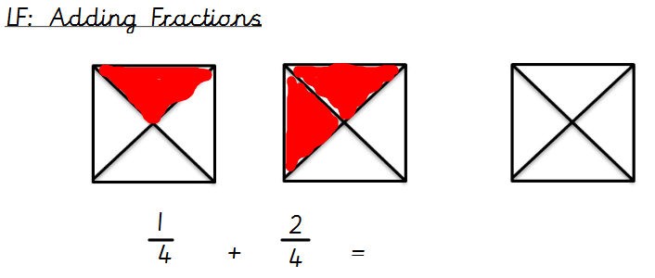
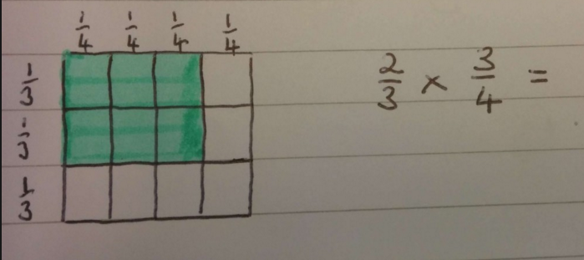
PICTORAL

Slide 15
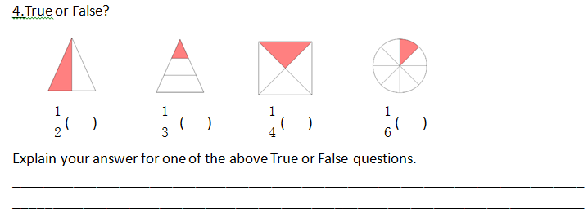
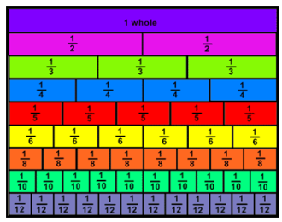
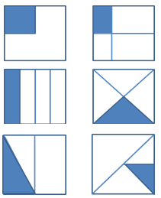
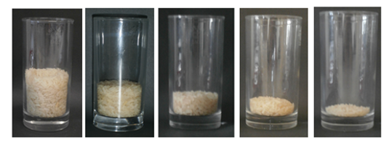

Slide 16
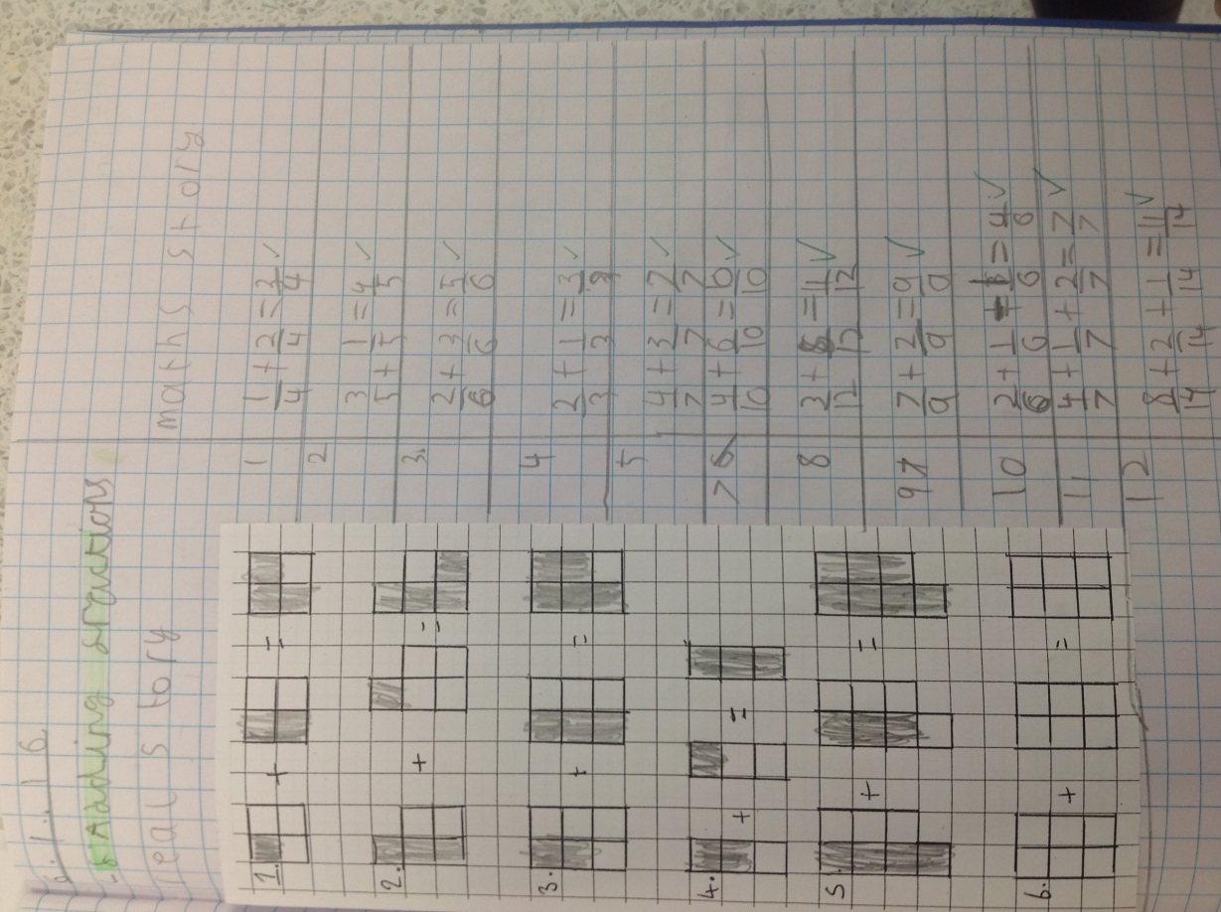
PICTORIAL AND ABSTRACT

Slide 17
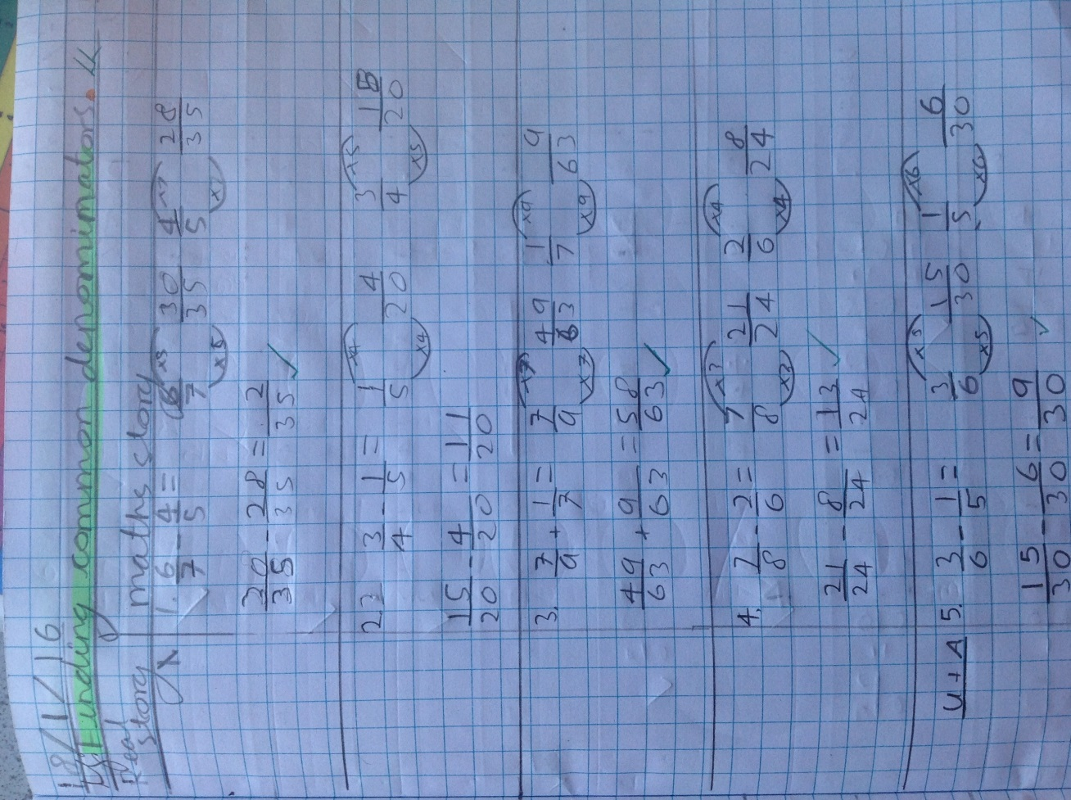
ABSTRACT

Slide 18
3 interpretations of fractions
1) Fractions as numbers in themselves
2) Fractions as operators on a set
3) Fractions as quotients in division

Slide 19
Fractions as numbers in themselves
0
1
2
3
4
5
Can you mark the number ½ on this number line?
What misconception might arise here?
Why? (Can you relate it to fractions as numbers in themselves vs fractions as operators on a set?)
Notes:
Children should count in 1/2s to show it as a number as well – only appears in Y2 NON-statutory guidance not NC.
Should use 0-2 numberlines

Slide 20
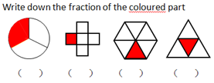
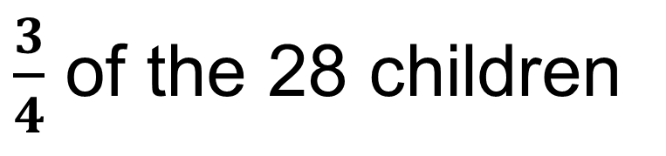
Fractions as operators on a set
$\frac{3}{4}$ of the 28 children

Slide 21
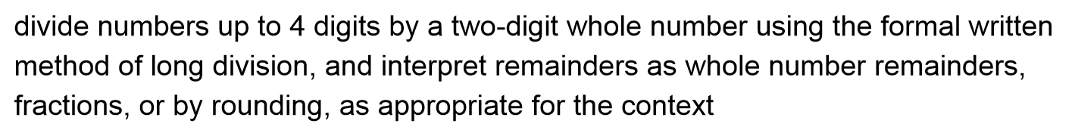
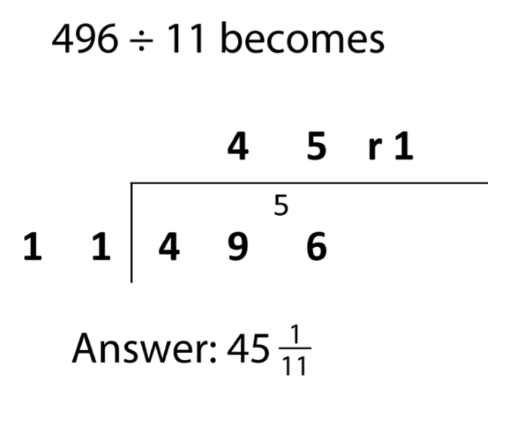
Fractions as quotients in division (year 6 only)

Slide 22
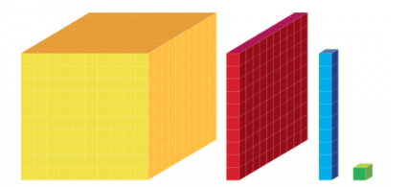
One
Hundredths
Tenths
Thousandths
Decimals

Slide 23
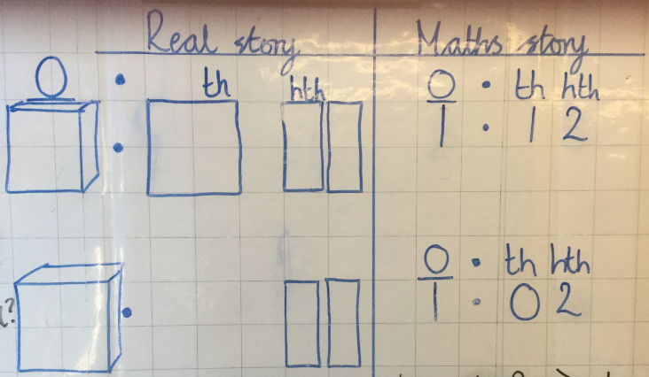
Pictorial decimals

Slide 24
How can you help your child at home?
Support them with their weekly maths homework.
Practice their times tables at home with them regularly.
Encourage them to use their maths skill in the real world including shopping, telling the time and sharing.
Have a positive attitude towards maths.

Slide 25
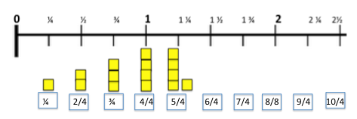

Help your children at home by counting

Slide 26
Times tables Rock Stars

Slide 27
Do you have any questions?

