Slide 1
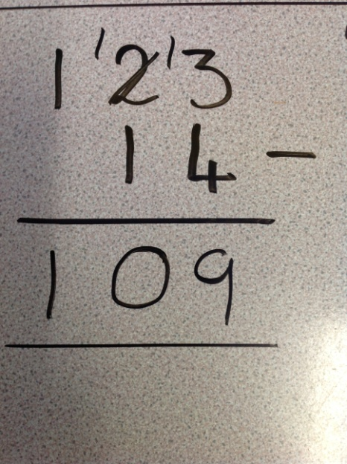
Maths at St Stephen’s Junior School
How has this calculation been solved?
What has the child done?

Slide 2
Our aim...
To help you to understand what your child experiences every day in maths.
To help you how your child will learn addition and subtraction.
To help you to support your child with their maths at home.

Slide 3
Our maths approach is…..
A mastery approach.
A split lesson.
A CPA (concrete, pictorial, abstract) approach.
Try it, use it, prove it.
We assess the children during the lesson using hinge questions and answer stations.
How do you know?

Slide 4
What does a hinge question look like?
157,903 + 15,024 =
A. 172,927
B. 308,143
C. 162,927
D. Not sure yet

Slide 5
157,903 + 15,024 =
A. 172,927 (correct answer)
B. 308,143 (incorrect place value columns)
C. 162,927 (incorrect carrying)
D. Not sure yet
Why are they useful during a lesson?

Slide 6
Try it, Use it, Prove it
Try it
1. ? = 123,084 + 28,187
Use it
1. Bailey went to the supermarket and spent £124.89 on a new television for her bedroom. She also bought two DVDs for £12.52 each. How much money did Bailey spend altogether?
Prove it
1. When adding you will always end up with a bigger number. Is this always, sometimes or never true? Prove you opinion.

Slide 7
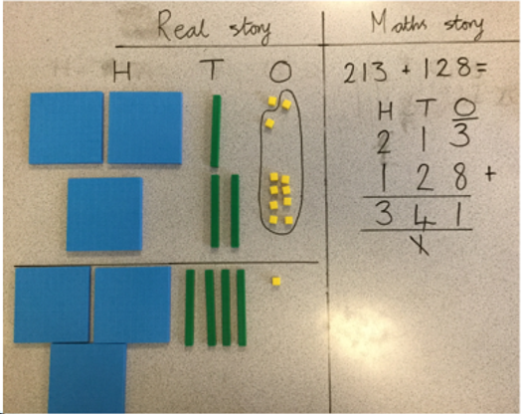
LF: Addition
Concrete

Slide 8
LF: Addition
Pictorial
I do (teacher models)
237 + 148 =
We do (children have a go with a learning partner and steps to success are built)
562 + 153 =
? = 339 + 243
You do (hinge question)

Slide 9
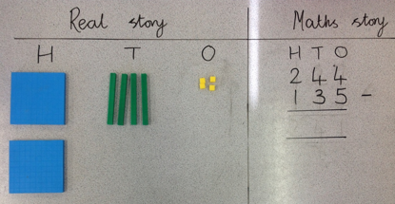
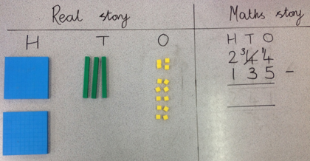
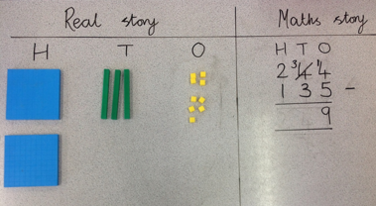
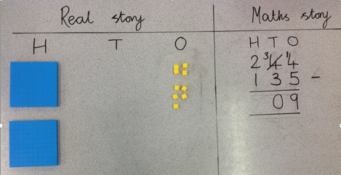
LF: Subtraction
Concrete

Slide 10
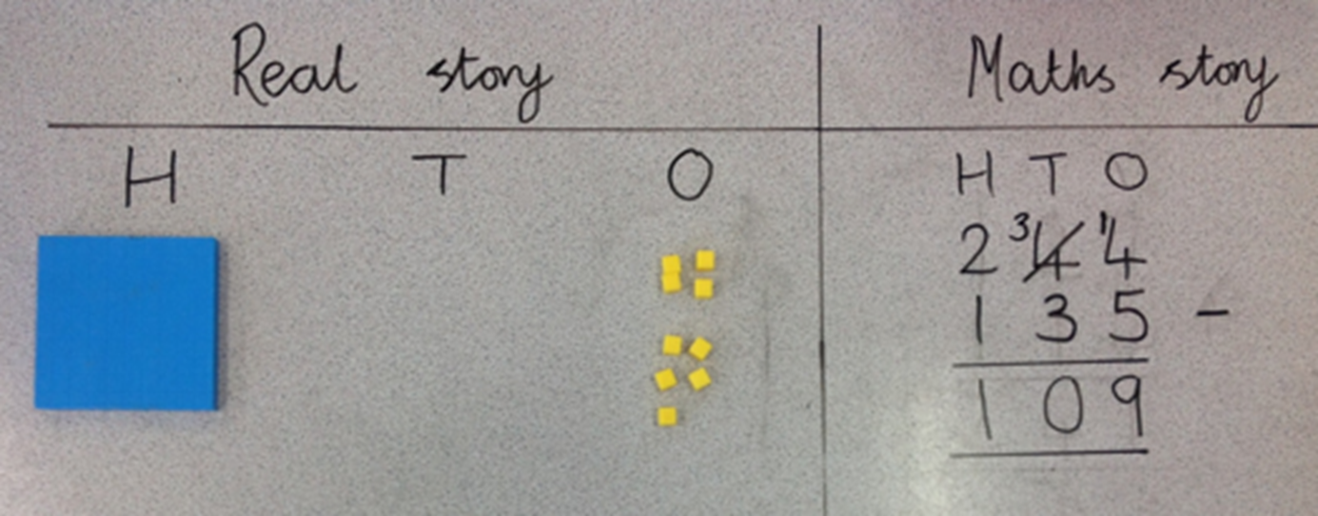

Slide 11
LF: Subtraction
Pictorial
I do
? = 153 - 135
We do
346 – 158 =
? = 109 – 74
You do (hinge question)

Slide 12
How can you support your child with maths at home?
Support them with their weekly maths homework.
Help them practise their times tables and mental maths.
Talk to them about their maths. Get them to explain how they know.
Ask their class teacher if you are unsure about how to support them with a particular context.

